Slide 1
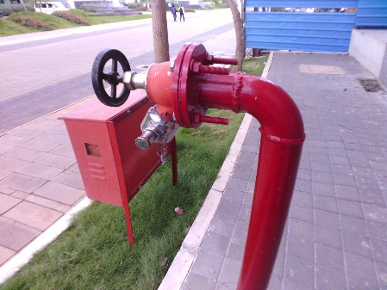
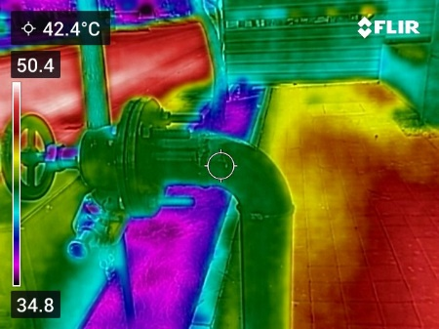
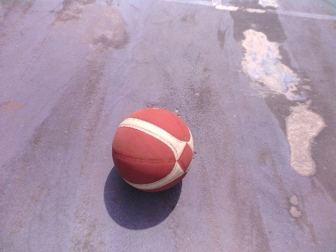
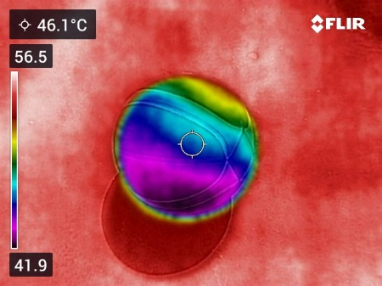
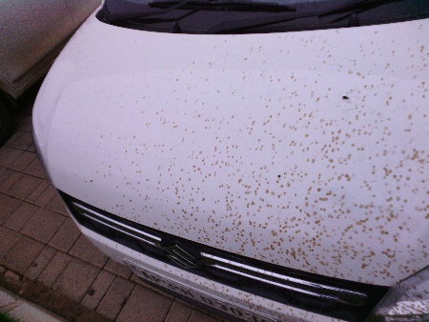
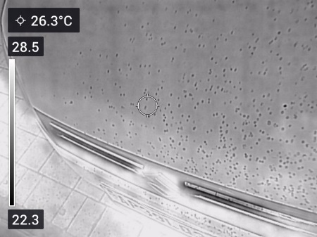
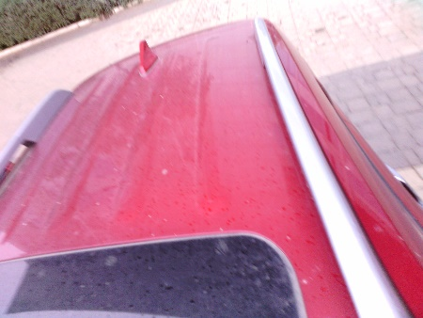
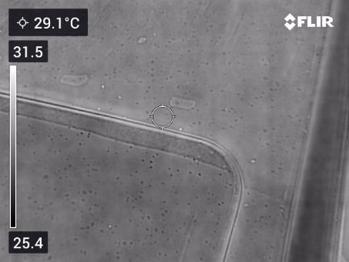
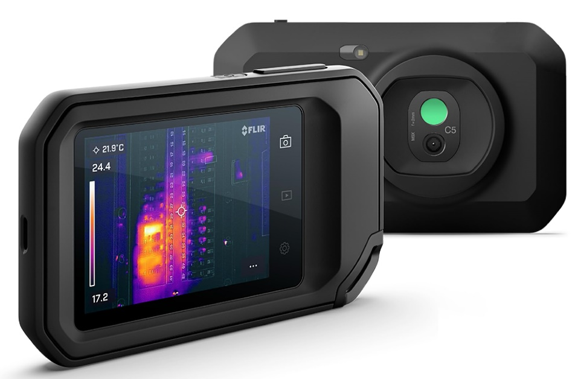
Thermal Image
Dr Shuvendu Rana
shuvendu@ieee.org

Slide 2
OUTLINE
Thermal Image
Different type of thermal images
Camera for thermal image
Application using Deep learning
Other possibility

Slide 3
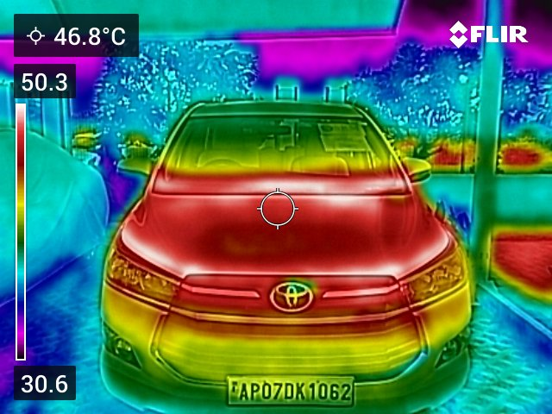
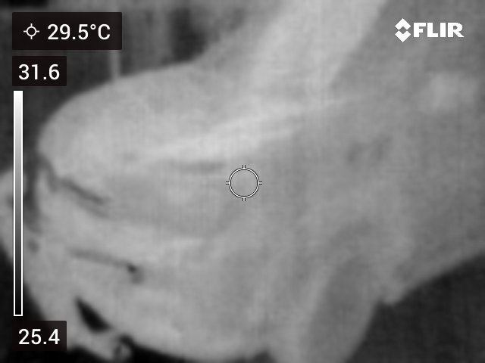
Thermal images

Slide 4
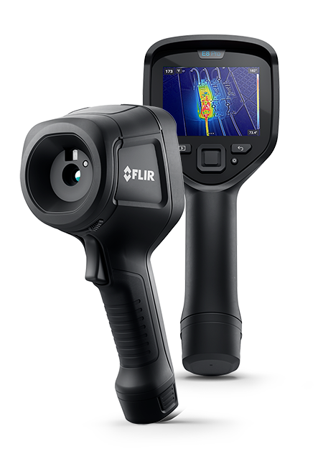
Camera
C5 thermal Camera
E6 thermal Camera

Slide 5
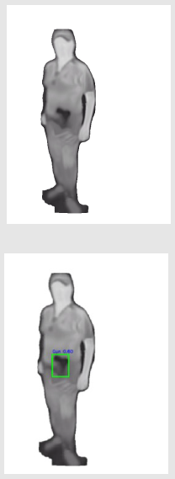
Concealed Pistol Detection
Thermal Image based Concealed Pistol Detection Using Background Elimination Technique, SIVA Rajesh, Shuvendu Rana, Nature scientific report

Slide 6
Contents:
Introduction
Related Work
Research Background
Proposed Framework
Results and Discussion
Conclusion

Slide 7
Abstract:
This study uses thermal imaging for concealed pistol detection, leveraging Vision Transformer for classification and YOLOv8 for localization. Background subtraction improves accuracy, achieving 97.75% classification accuracy and 98.84% mean average precision, outperforming existing methods.

Slide 8
Introduction:
Pistols can be hidden under clothing, making it hard for conventional visual inspection systems to detect them. This is especially true in scenarios where individuals may attempt to carry weapons in public places or secure environments like airports. But in this case, thermal cameras are more efficient than normal cameras, because normal cameras cannot detect concealed pistols, but the thermal cameras can detect concealed pistols inside the cloths.

Slide 9
Related Work:
Doan, T.S., Nguyen, T.K.T., Vo, T.A.:Weapon detection with yolo model version 5, 7, 8 (2023)
Jiang, Z., Zhao, L., Li, S., Jia, Y.: Real-time object detection method based on improved yolov4-tiny. arXiv preprint arXiv:2011.04244 (2020)
Gonz´alez, J.L.S., Zaccaro, C., ´Alvarez-Garc´ıa, J.A., Morillo, L.M.S., Caparrini,
F.S.: Real-time gun detection in cctv: An open problem. Neural networks 132,297–308 (2020)
Veranyurt, O., Sakar, C.O.: Concealed pistol detection from thermal images with deep neural networks. Multimedia Tools and Applications 82(28), 44259–44275(2023)

Slide 10
Research Background
Vision Transformer
YOLOV8
YOLOV8 Segmentation

Slide 11
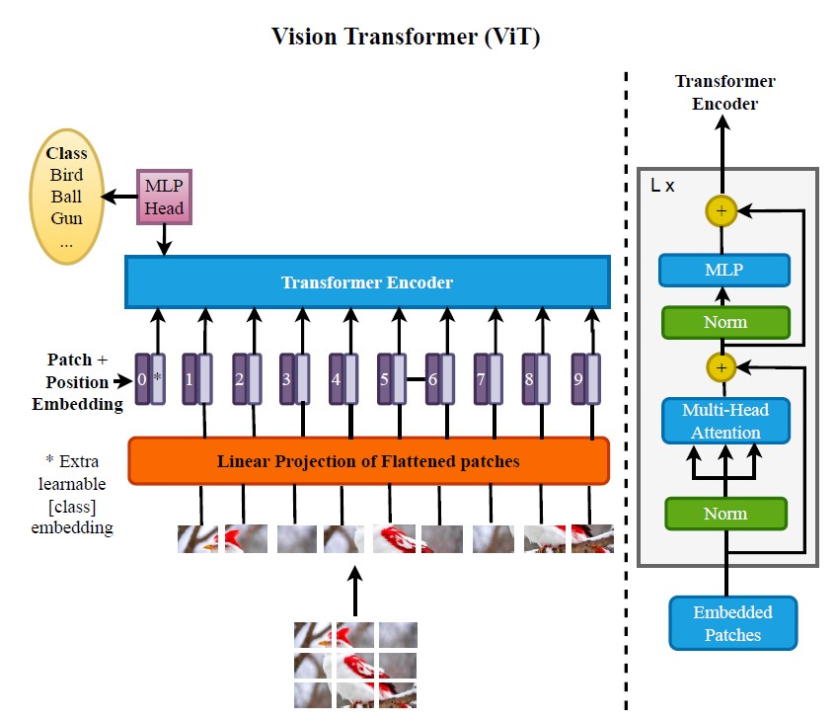
Vision Transformer
The Vision Transformer breaks the thermal image into fixed-size patches and embeds each one into a higher-dimensional space. This process allows the model to treat each patch as a separate token, similar to words in a sentence, enabling the attention mechanism.
https://huggingface.co/docs/transformers/en/model_doc/vit

Slide 12
YOLOV8
You only look once :YOLOV8 serves as a highly sophisticated, instantaneous object recognition model crafted by Ultralytics.
It is the latest iteration in the YOLO family, building upon the advancements of previous versions to offer enhanced accuracy, speed, and flexibility.
YOLOV8 is designed to be highly efficient, making it ideal for diverse use cases, from simple object detection tasks to complex multi-object detection scenarios in real-time environments.
https://yolov8.com/
Advance version YOLO V 11 https://github.com/ultralytics/ultralytics

Slide 13
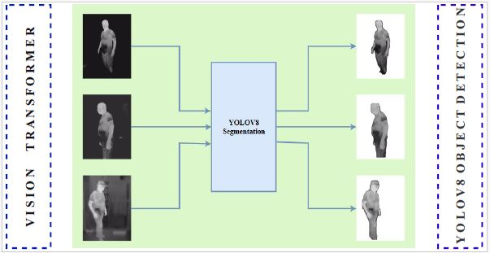
YOLOV8 Segmentation:
It is used to eliminate the background of thermal image

Slide 14
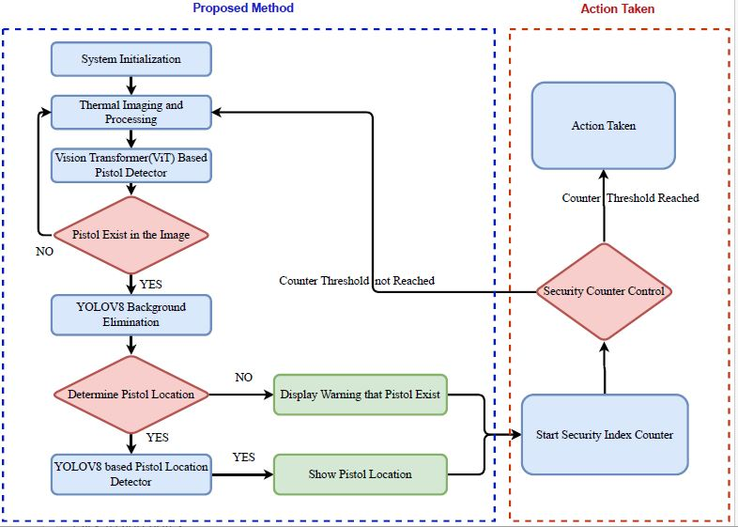
Proposed Architecture:

Slide 15
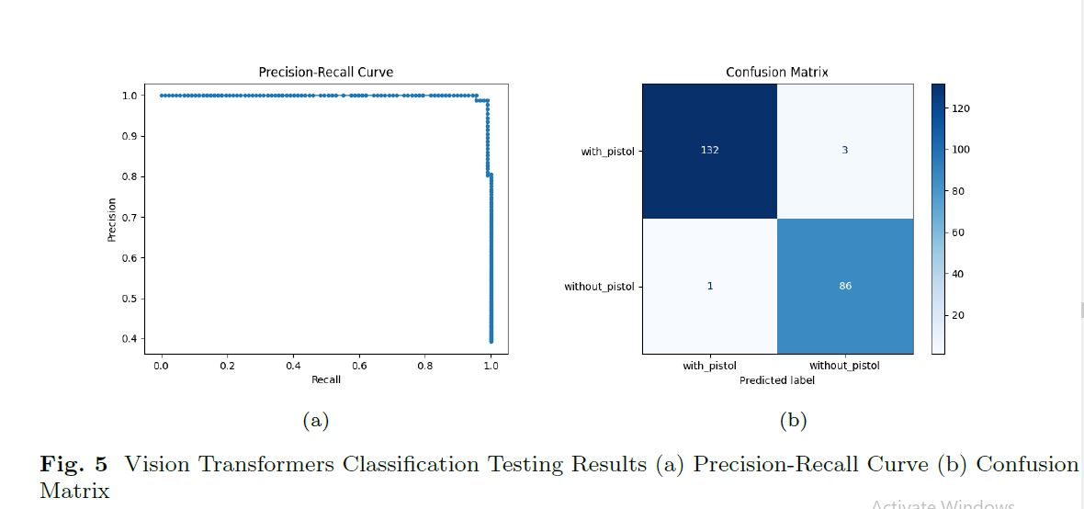
Results and Discussion:
Vision Transformer Classifies the thermal image as follows

Slide 16
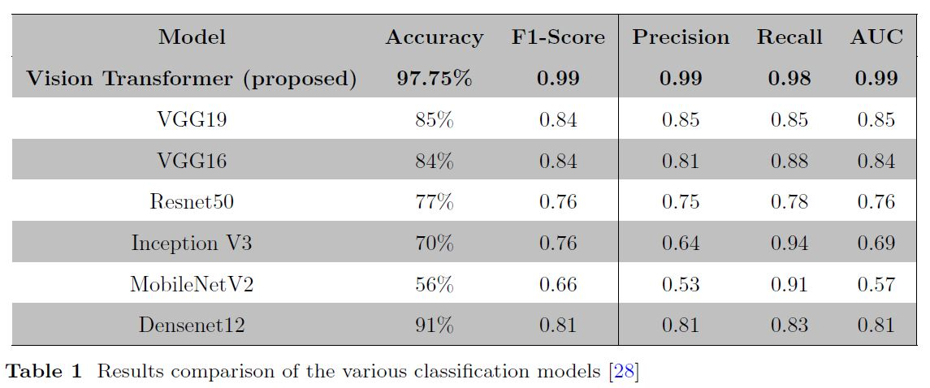
Different Classification Results:

Slide 17
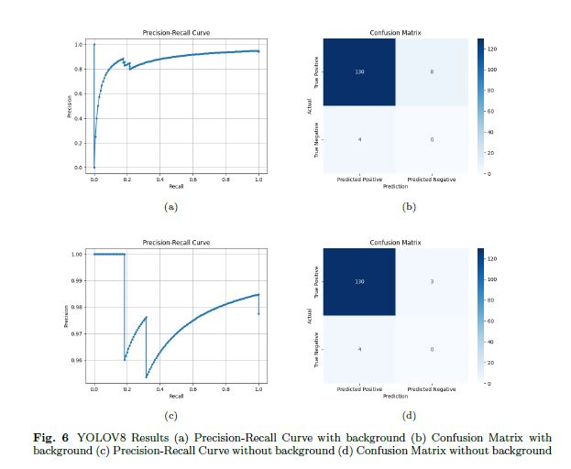
Difference Between with and without background:
From the figure, it is clearly observed that false positives are reduced without background, so that accuracy was improved

Slide 18
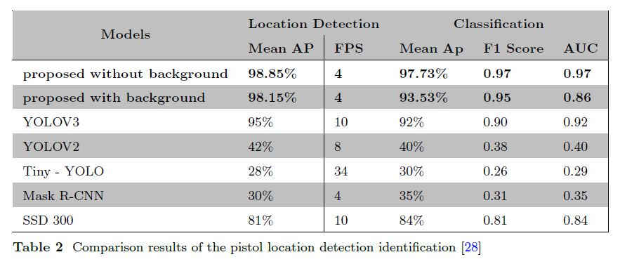
Different Object Detection Results:

Slide 19
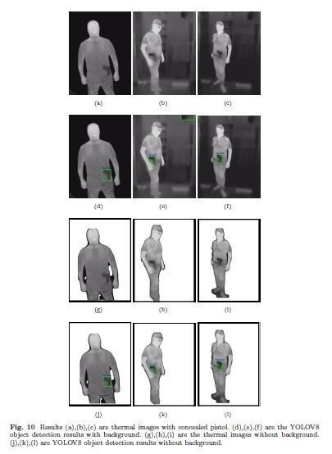
Final Results:
a,b,c are the input image. Where d,e,f are the background removal using YOLO segmentation.
Here d,e,f are pistol detection with out background removal and j,k,l are with background removal.

Slide 20
Summary:
Proposed a combination of Combination of Vision transformer and YOLOv8 for concealed pistol detection.
Proposed a background elimination method to improve the accuracy
Can be used real time scenario

Slide 21
Future of thermal image
Metal classification
Thermal Conductivity measurement

Slide 22
Discussion and doubts…..

